Slide 1

Hotel Cancellation

Slide 2





PROJECT GUIDE
Data source
EDA
Pre-processing
Modeling
Conclusion

Slide 3



DATA SOURCE
18
6
3,988
Datasets Export
Datasets
Jesse Mostipak
Data Science at RStudio
Gold Medals
Followers

Slide 4


quantitative
20
+119 K
Data Type
Size
12 qualitative
32
value
129,421
Missing values
Outliers
17
Row
3
columns

Slide 5
EDA
Features expected values
Cancelation per month
Hotel type per month
Hotel type per country

Slide 6
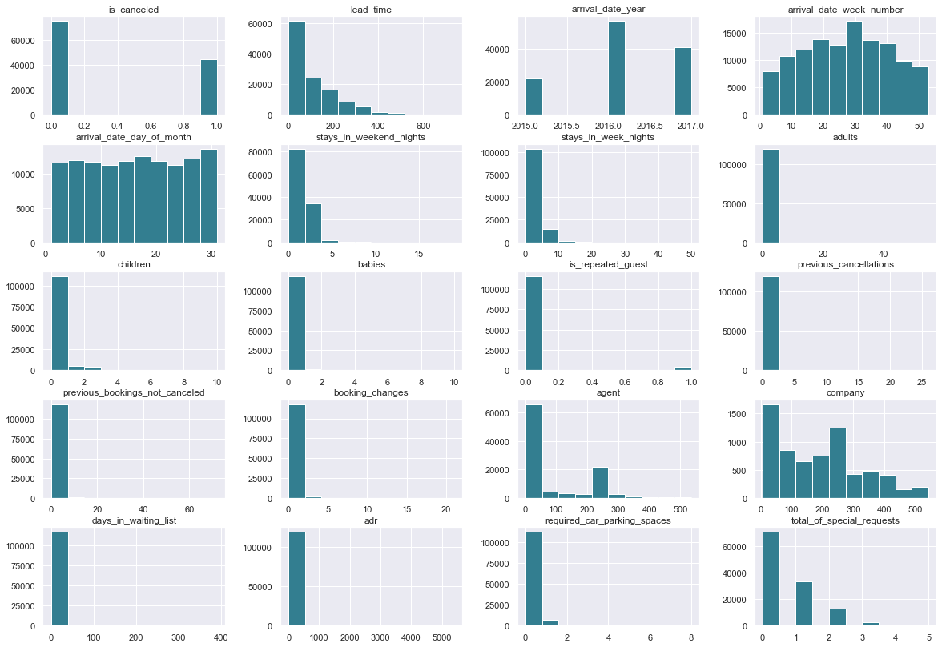

Slide 7
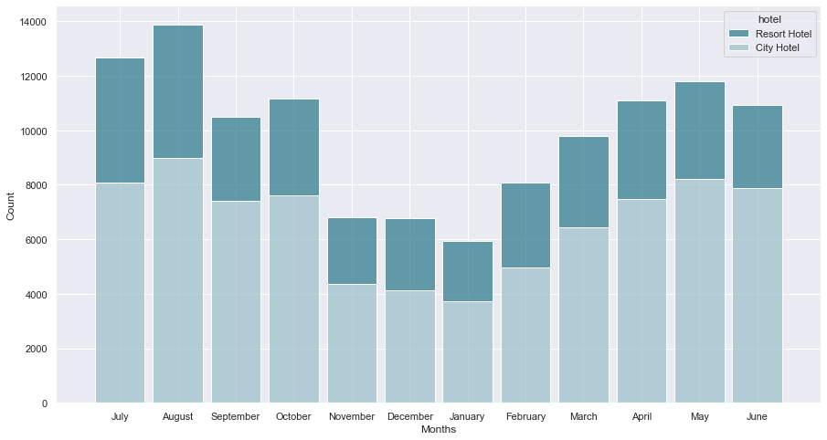

Slide 8
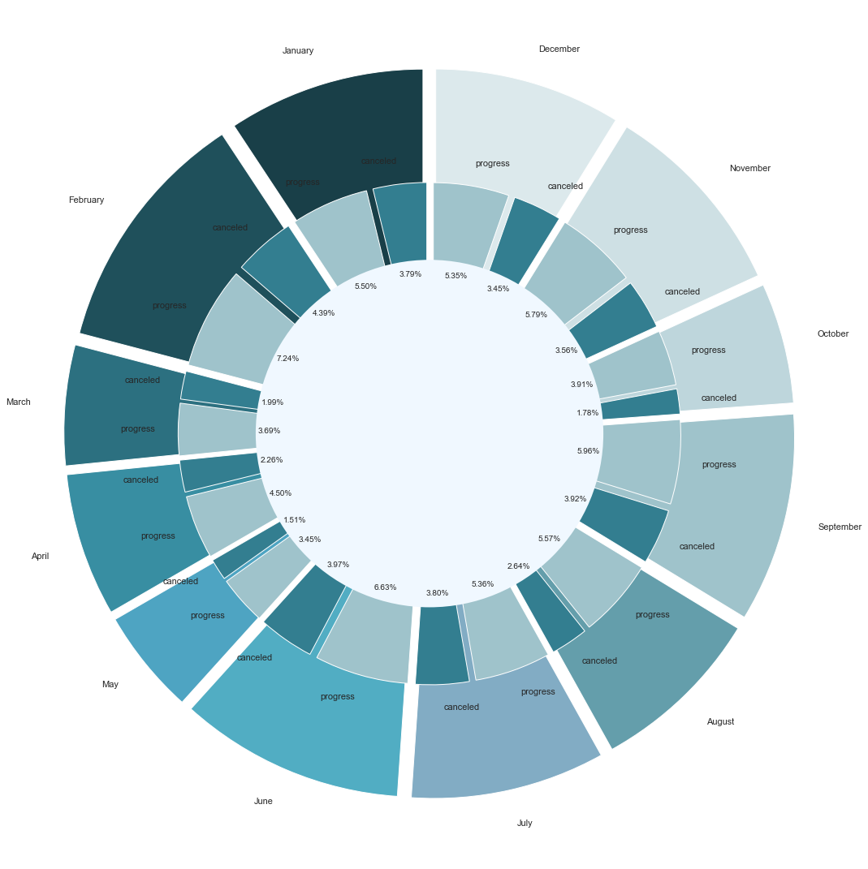

Slide 9
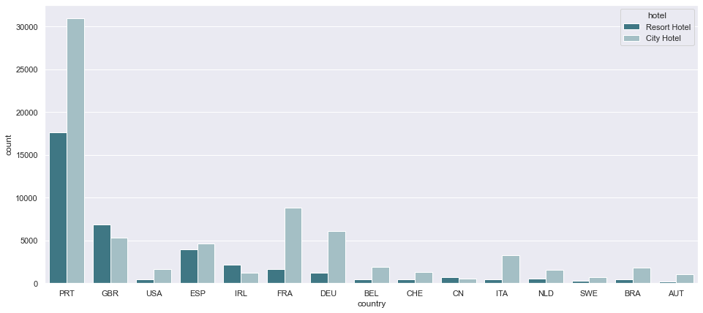

Slide 10
PREPROCESSING
Data Balancing
Data Correlation
Update Values
Remove Useless Data

Slide 11
Data Balancing
37%
63%
Canceled
Not Canceled

Slide 12
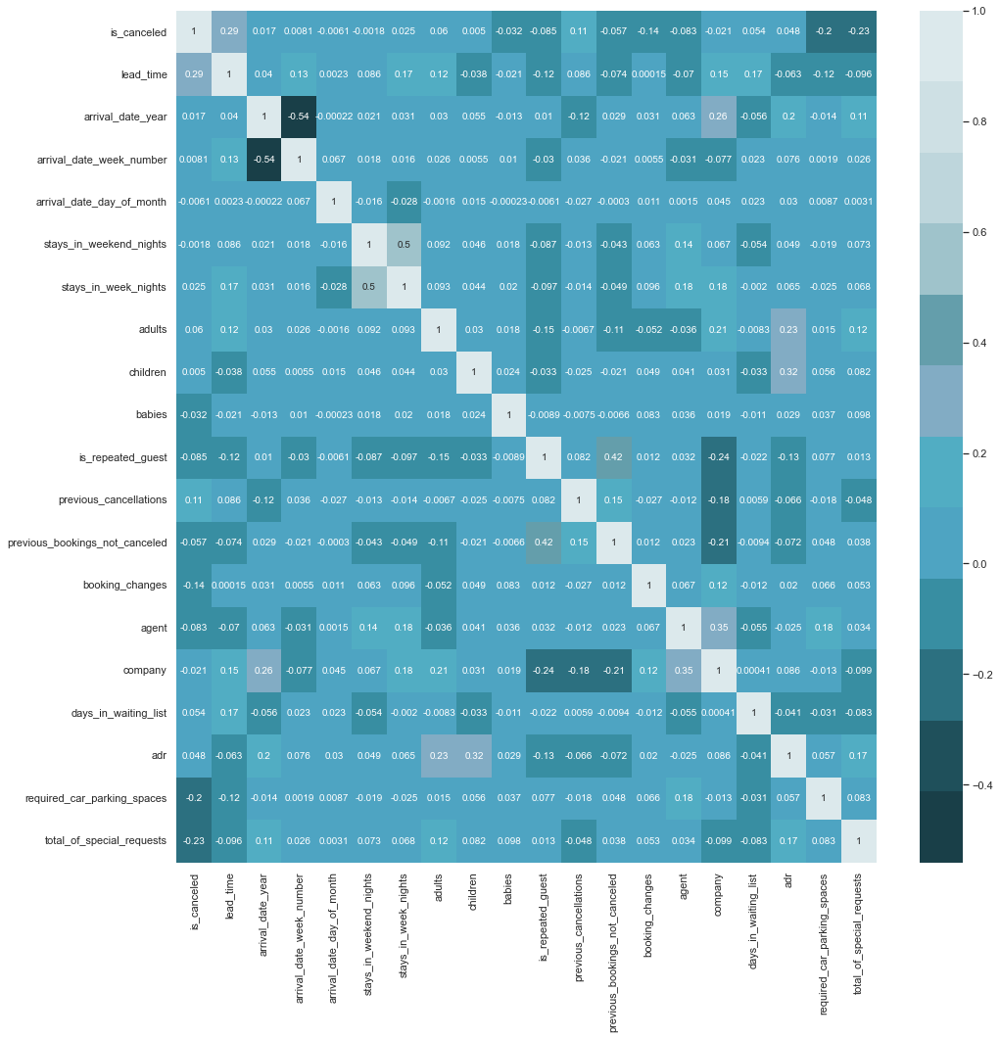

Slide 13
Update Values
 | Hotel | Months
Replace value | Contain two type, City Hotel and Resort Hotel replace them with 0 and 1 | Replacing the month names by its numbers
 | Rooms | Last Status
Create values | Combine two columns if it’s equal each other assign 1 else 0 | Extracting new values from ReservationStatus

Slide 14
Remove Useless Data
The data that can cause any type of bad influence will be removed

Slide 15
Modeling
Data
ALGORTHIMS
80%
20%
9
1
Training Data
Testing Data
Models
Selected

Slide 16
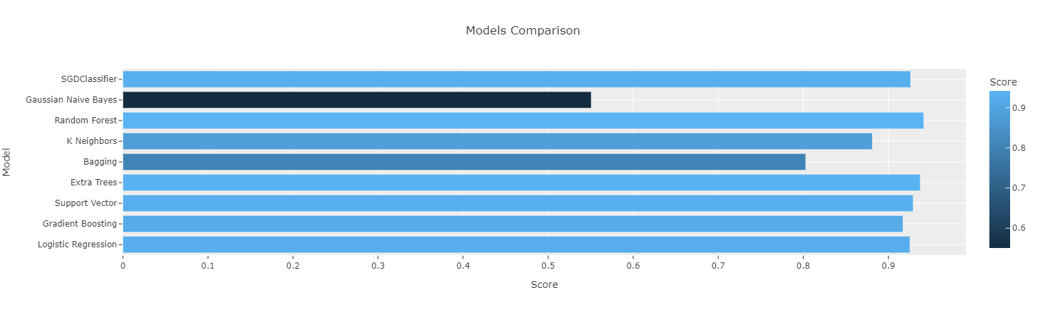

Slide 17
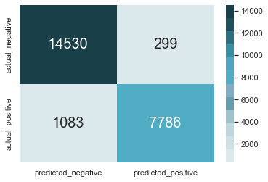
Result
Random Forest Classification
Classification Report
Conversion Matrix
precision recall f1-score support
0 0.93 0.98 0.95 14829
1 0.96 0.88 0.92 8869
accuracy 0.94 23698
macro avg 0.95 0.93 0.94 23698
weighted avg 0.94 0.94 0.94 23698

Slide 18
CONCLUSION
94%
Accuracy
Random Forest Classification
99%
Training Score

Slide 19
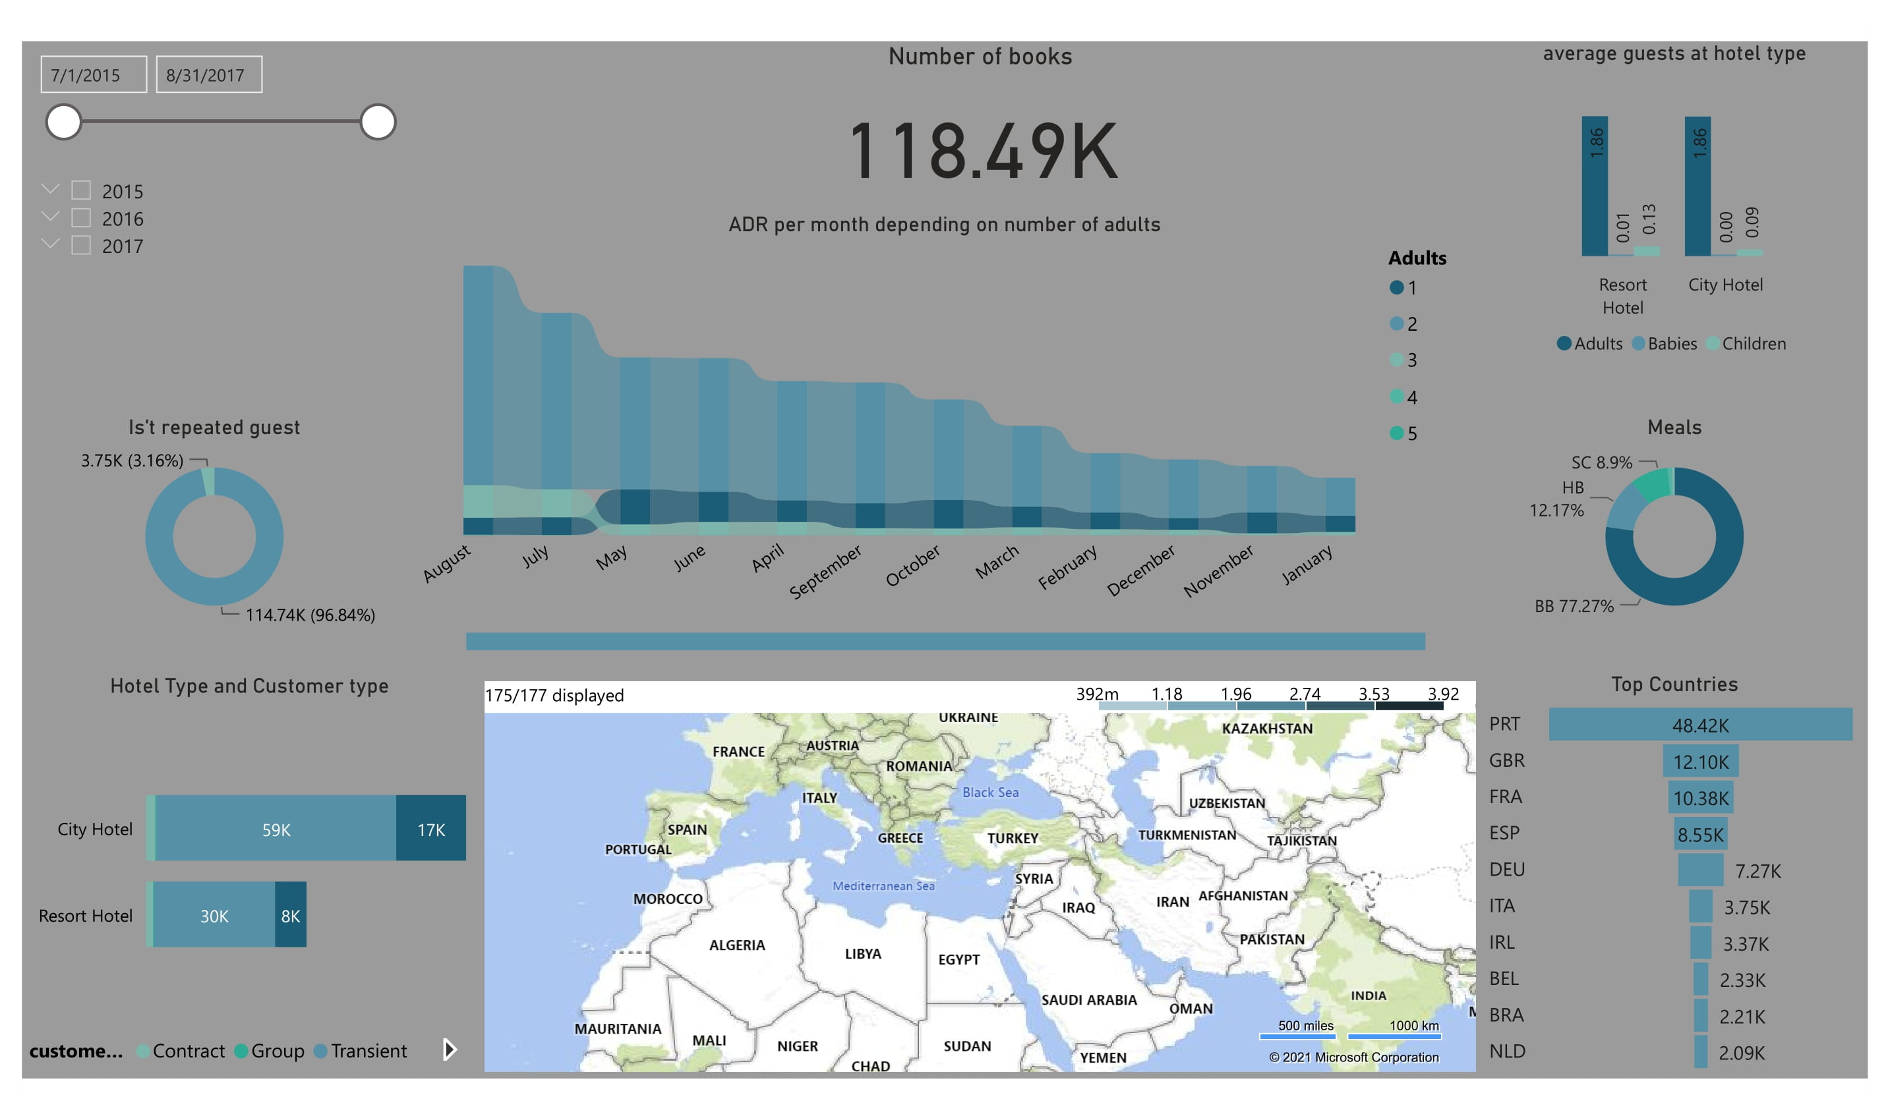
ADDITIONAL STEP
POWER BI
Interactive dashboard that can represent the data in nice way

Slide 20

THANKS!
DOES ANYONE HAVE ANY QUESTIONS?
Abdulaziz Alkhonain

